Slide 1
Making a difference to practice: challenges and opportunities
Dr Lara Allen
Director – the Humanitarian Centre
Global Food Security Cambridge Symposium 2015

Slide 2
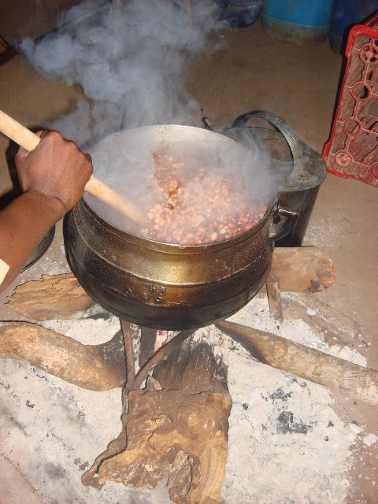
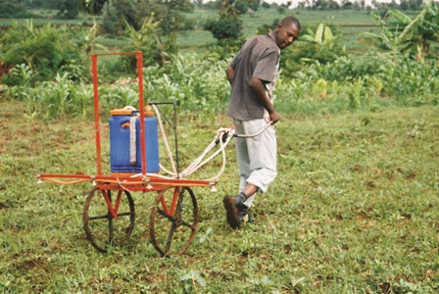
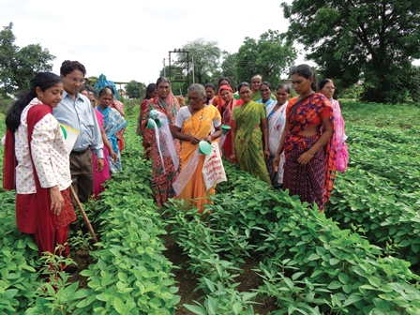
Overview
Brief: “provide an NGO perspective on how the academic community could make a bigger impact from their research in the area of food security”.
Preferred question: “how academics and NGOs can work together to impact positively on food security”
The Humanitarian Centre – past and future
Our approach to achieving impact from academic work
Discussion about how we can work with Food Security academics to increase impact of research

Slide 3
The Humanitarian Centre: who we are and what we do
network of NGOs, academics and businesses who work together to address global inequality and poverty
Basic Premise: cross-sector collaboration generates innovative approaches to big challenges in international development
Challenge: sectors have different approaches, languages, and metrics for success
Contribution: provide the link / bridge / translation / mediation

Slide 4
The Humanitarian Centre - Past and Future
Past 5 years organised by theme
2014 Theme: Global Food Security
Recent strategic planning:
New strategy
New name
New metrics of success (outcomes)
Implications:
positively impact the lives of poor people in the developing world.
Less events – more longer-term initiatives.

Slide 5
Going forward – The Centre for Global Equality (CGE)
Name: The Centre for Global Equality
Aim: To address knowledge inequality and its effects on the lives of the bottom billion
Reduce Knowledge Waste
by transporting it from where it is being under used to where it is needed
from universities, businesses, global civil society to communities living under $2 / day

Slide 6
How? – models in formation
Identify
Convene
Incubate
Integrate
Support
Presently evolving different models of doing this
From starting point in one of three sectors (civil society; academia; business) usually integrating others
Starting in civil society we follow our innovation incubation pathway

Slide 7
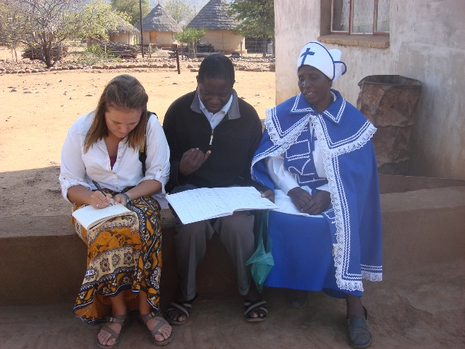
Starting in universities
Exploring potential through research, coursework and extra-curricular volunteering.
Volunteering
- Best practice in international volunteering (policy)
- 12 CU student societies are members of the Humanitarian Centre
Coursework
- class projects (computer lab; sustainable engineering; JBS)
- support individual short undergraduate & research projects
Research (post-graduate to post-doctoral)

Slide 8
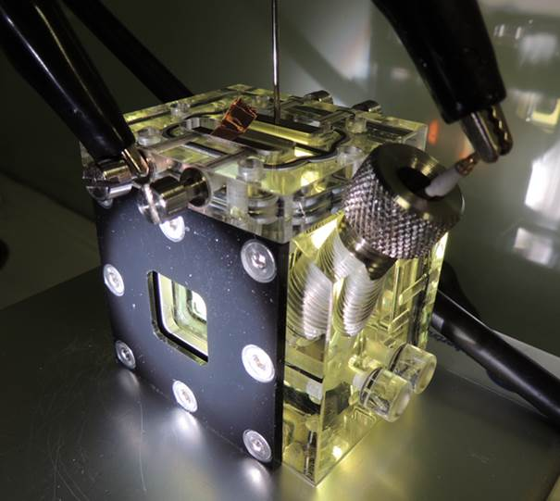
Creating an enabling environment for research to make positive impact ??
E.g. Development i-Teams
Investigating whether particular technologies could be used in the developing world to good social and environmental effect.
Material science (Vasant Kumar lab) Alternative technology to recycle lead acid batteries
Chemistry (Erwin Reisner’s Sunshine Lab) Possible uses of hydrogen as a fuel in off-grid communities
The Humanitarian Centre is committed to supporting solutions with potential through the necessary stages to impact
We would like to collaborate during not just post research implementation

Slide 9
How to increase impact of food security research?
What are the blocks to achieving impact on the ground through research?
Different metrics for success (implementation not worthwhile for academics)
Academics usually very specific answers to very specific questions. This provides a single active ingredient/catalyst. But a catalyst on its own can’t cause a reaction, it needs to be mixed with other chemicals and often a medium
The Humanitarian Centre aims to provide that medium and other chemicals by:
Convening other expertise – collaborators from different disciplines and sectors, including developing world communities – ground truth and test experimental solutions.
Sourcing other resources – not provided for within academic programme (funds; space; equipment)
Providing ongoing facilitation and support

Slide 10
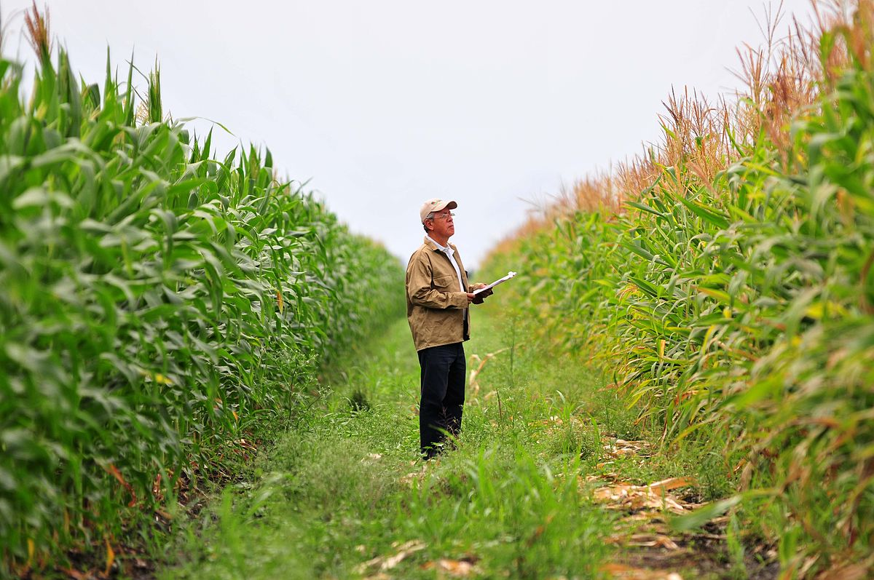
Why not leave impact to non-academics?
Because civil society:
doesn’t have access to research results (closed access journals)
rarely has the expertise to understand disciplinary jargon
funding structures are very risk averse (results are defined at the beginning – reduces innovation)
works in silos
generally over-stretched and resource-poor

Slide 11
This is a missed opportunity …
… for academia, civil society and the hungry of the world
Food security interventions could be more innovative & sophisticated
Dialogue can enrich research
Research could be more useful if undertaken in conversation with potential ‘end users’ thanks to reality checks about implementation context
re-focus the nature of the research question and/or generate new ones.
Different contexts have different opportunities and challenges (e.g. change parameters such as scale and/or competition)

Slide 12
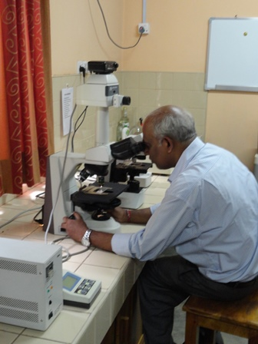
What do you think the blocks and solutions are?
As academics
What stops you from working with non-academics to increase impact of your research?
What could be done to address these blocks?
And finally …
… If you are doing some research with the potential to make a significant difference, but you don’t know how to go forward, please come and talk with us.

